Slide 1
Sprint 1 Demo
1095-B TAX DOCUMENT
Tuesday, February 8th, 2022

Slide 2













Get to know the team
Core team
Executive team
PRODUCT
ENGINEERING
Ashley Castillo Washington DC Product Manager Lead
Jordan White Dallas, TX Product Manager
Tami Corson
North Carolina
Scrum Master
Nadya Primak Washington DC Engineer
Jeff Scheire
MO Studio
Marcy Jacobs
McKinsey
Kevin London frog
DESIGN
Kit Casey Boston, MA Design Director
Carl Dickerson Atlanta, GA Content Strategist and Plain Language Content Creator
Grace Hong New Jersey Experience Designer
James Lewis Austin, TX Accessibility and UX Research Lead
Will Reynolds Serve
Ben Morris
Pluribus
02-08 Sprint 1 Demo
*Day to day working team will be adjusted through project lifecycle if new skillset needs arise
‹#›

Slide 3



At the end of each sprint on Tuesdays, the team will run sprint reviews to showcase the sprint’s work for approval. The purpose of this meeting is:
WELCOME TO THE SPRINT 1 DEMO
1
To demo the accomplishments or functionality that was built over the past sprint
2
To get feedback and insights early and often
3
To create transparency for anyone interested on the product and progress
02-08 Sprint 1 Demo
‹#›

Slide 4
Roadmap Overview
We are here
PHASE
CY 2021
CY 2022
SPRINT
0
1
2
3
4
5
6
7
8
9
10
11
12
13
14
15
16
17
18
19
20
21
22
23
24
25
MONTH
Sep
Oct
Nov
Dec
Jan
Feb
Mar
Apr
May
Jun
Jul
Aug
FOCUS
DHM - Health Apartment
1095-B Form
TBD
02-08 Sprint 1 Demo
‹#›

Slide 5
1095-B Overview
SPRINT 1 DEMO
02-08 Sprint 1 Demo
‹#›

Slide 6
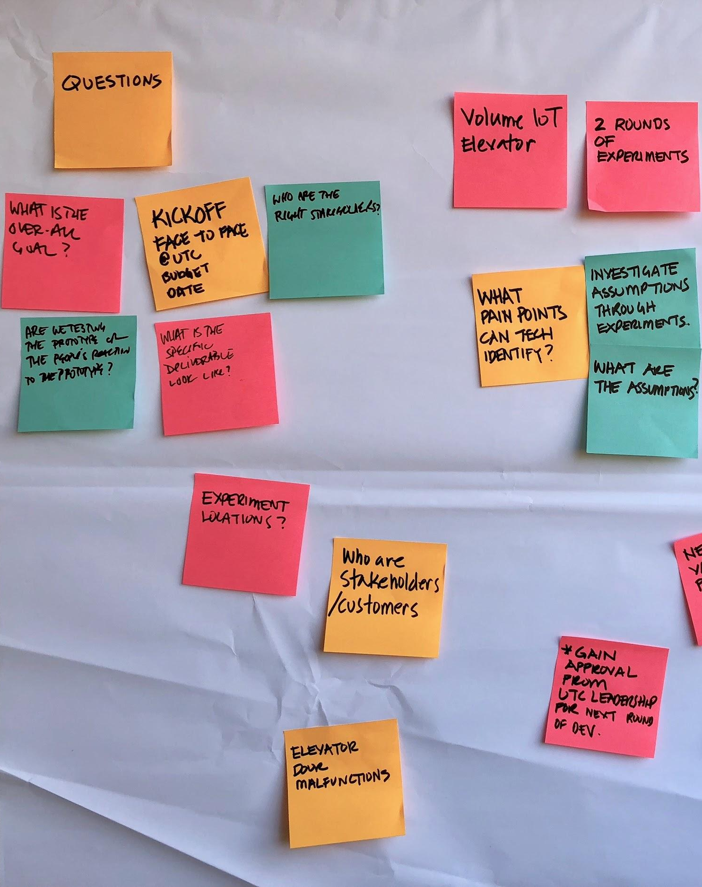
Project objectives
Digitize 1095-B form on VA.gov so Veterans can easily access the form and download the form for their records
Goal: April 1st MVP Launch
02-08 Sprint 1 Demo
‹#›

Slide 7




1095-B Project Status & Workplan
Owned by design team
Owned by product/ engineering team
Release
We are here
Sprint 0
Sprint 1
Sprint 2
Sprint 3
Sprint 4
Sprint 5
Week 1: 01/20 – 01/26
Week 2: 01/26–02/02
Week 3: 02/02 – 02/09
Week 4: 02/09 – 02/16
Week 5: 02/16 – 02/23
Week 6: 02/23 – 03/02
Week 7: 03/02- 03/09
Week 8: 03/09 – 03/16
Week 9: 03/16 – 03/23
Week 10: 03/23 – 03/30
Product & Delivery
Build backlog
Identify Change Management or Communications Plan
Handover plan - Prepare for launch
PIV Onboarding
Prioritized backlog
Immersion & onboarding
User Experience & Design
Immersion & onboarding
Testing prep
Testing prep & recruiting
Create post-MVP design refinements
Voice of Veteran
Voice of Veteran
PIV Onboarding
Wireframes & Design
Design iterations
Design iterations
Design QA
User flows
Engineering & Development
Create tech discovery plan
Data discovery
POC for data flow
Immersion & onboarding
Define data flows - Systems mapping
Build solution (form UI, data connections, storage, etc.)
UAT
Test & Refine
Collaboration Cycle
Kickoff
Analytics Review
Research Plan Review
Design Intent
Research Plan Review #2 (wireframes)
Midpoint Review
Contact Center Review
Privacy & Security review
Staging Review
MVP Launch
*Does not show Validate phase meetings in Collaboration Cycle, such as Full Accessibility Audit and Post-Launch Check In
02-08 Sprint 1 Demo
‹#›

Slide 8
SPRINT 1 DEMO
Sprint 1
02-08 Sprint 1 Demo
‹#›

Slide 9
Agenda for today’s Demo
Focus for today's demo
Sprint Goal: Sprint 1 was focused on discovery to understand the current state and draft out what would be in the future state and how we would build it
User Story
1
PRODUCT
Conduct product discovery through stakeholder interviews to pull insights
Draft product outline
Draft prioritized backlog for MVP and post-MVP enhancements
2
DESIGN
Draft the user flow and decision paths of how a Veteran would access the form
Illustrate key moments in the Veteran happy path for future state
Write content for 1095-B pages
Prepare for user research by creating the documentation needed to conduct research
3
TECH
Conduct data discovery to understand where the data sits and what systems house the data we need
Map out how the data flows through the systems in current state and how we would pull it in future state
 | We welcome all feedback! Feedback will be collectively reviewed and prioritized appropriately based on where it stacks against other stories in the backlog as well as technical feasibility
02-08 Sprint 1 Demo
‹#›

Slide 10
We met with 5 stakeholders throughout Sprint 1 to get a baseline of the current state
1
PRODUCT
User Story: Conduct product discovery through stakeholder interviews to pull insights
STAKEHOLDER | MEETING DATE | KEY TAKEAWAYS (NOT EXHAUSTIVE)
Tarsha Tremble – 1095-B Business Owner | 1/25/22 | Data sits in enrollment system The data is sent to a print vendor, who creates a PDF, prints it to send to Veterans, and sends the PDF back to the VA Currently, a Veteran can call the enrollment center to fix a mistake. The print vendor can then print and send a corrected form
Jason Woodman – Contact Center | 1/31/22 | There are three escalation tiers for problems. Tier 1 answers simple questions, Tier 2 takes more complex escalations, and Tier 3 requires specialized knowledge of the backend The product guide and video can help guide Tier 1 and Tier 2 in supporting the Veteran when they call in for questions
Matt Self – Forms and Letters | 2/1/22 | 1095-B form might fit better in "Letters" than "VA Forms", as Letters pertains to records The Letters system is built in a way that once you are logged in, the system can pull up all records associated with your identifier without you needing to search for it
Joshua Falkner (OI&T), George Tidwell (Informatics) | 2/2/22 | Cleared path for creating the 1095-B PDF while helping eliminate options we were previously considering Print vendor has 10 days to submit the PDFs back to the VA Current data in the enrollment system wouldn't be representative of what was sent to the print vendor We would get a new data file if the Veteran makes a correction on their form We can retrieve flat file of data sent to print vendor from enrollment system via batch script for processing into PDF
02-08 Sprint 1 Demo
‹#›
Stakeholder Interview Notes Link

Slide 11
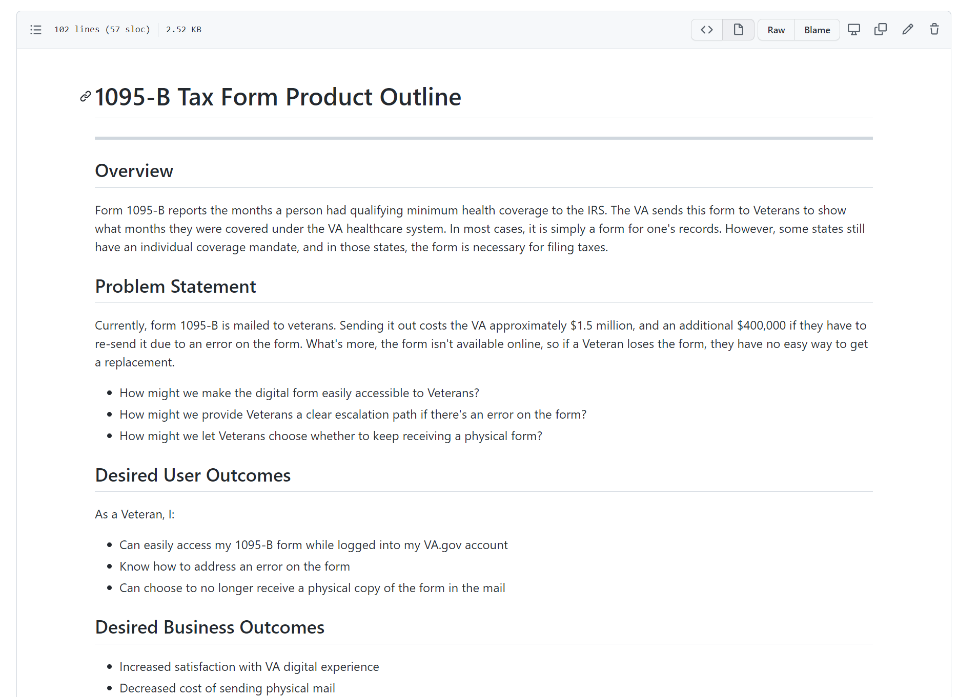
From what we learned, we built the product outline for our long term product vision
1
PRODUCT
User Story: Draft product outline
DESIRED OUTCOMES:
As a Veteran, I…
Can easily access my 1095-B form while logged into my VA.gov account
Know how to address an error on the form
Can choose to no longer receive a physical copy of the form in the mail
02-08 Sprint 1 Demo
‹#›
Product Outline Link

Slide 12
1
PRODUCT
We aligned on what features would fall into MVP and what would likely be post-MVP
User Story: Draft prioritized backlog for MVP and post-MVP enhancements. Features and MVP alignment pending validation from user research.
Find the Form
Access the Form (Unauthenticated)
Access the Form (Authenticated)
Get Help
Must Do (MVP)
As a Veteran, I want to easily find the form through Google so that I can find it through my normal methods
As a Veteran, I want to quickly navigate to my form once I log in
As a Veteran, I want to use VA.gov Search functionality to easily find my form
As a Veteran, I want to learn about the form, so that I know whether or not I need to log in and download it
As a Veteran, if I'm not logged in, I want to be redirected to login to be able to download the form
As a Veteran, I want to understand what the form is so that I know what to do with it
As a Veteran, I want to download my form so that I can have it for my records
As a Veteran, I want to fix a mistake in my form to avoid any issues with my taxes
As a Veteran, I want to ask a question about the form so that I understand what to do
Should Do (Fast Follow, Post MVP)
As a Veteran, I want to be informed that the form is now available online so that I am aware of the form's new "home"
As a Veteran, I want to opt out of getting mailed the form so that I no longer receive a mailed form unless I specifically ask for it
As a Veteran, I want to know how long it will take for my form to be updated (expected wait time) and confirmation when it's done, so I don't have to update it again
Could Do (For consideration Post MVP)
As a Veteran, I want to view the form without downloading it so that I can easily see what my filled in form is
Would Do (Long Term Backlog)
As a Veteran, I want to easily share my form via email so I can send it to myself or others straight from the site
02-08 Sprint 1 Demo
‹#›
Note: Additional user stories that were considered and deprioritized out of the product backlog by the Business Owner noted in the Mural
Mural Board Link

Slide 13
1
PRODUCT
We noted where we wanted to be able to track metrics on our MVP and Post MVP features
User Story: Draft prioritized backlog for MVP and post-MVP enhancements. Metrics and MVP alignment pending validation from user research.
Find the Form
Access the Form
Get Help
MVP
Number of users who find the page through Google
Number of users who search for the form on VA.gov
Tracking navigation from entering VA.gov to getting to our page
Number of users who land on the 1095-B page (page views)
% of users who land on the form and download the form or choose to not download it
When users typically visit the page (e.g., right before tax season or after)
Number of users who get errors and cannot download the form and type of errors
Repeat users (% of users who download multiple times)
Number of users who land on the page authenticated vs. unauthenticated
None for MVP
Post MVP
From which channels users accessed the page (social media link, newsletter link, etc.)
Numbers of users who opt-in to online-only delivery
Number of users who get redirected from other parts of VA.gov
If we build view functionality. Number of clicks on "view" pdf instead of "download"
Long term: Reduced cost for the VA to send the form by mail
Number of addresses proactively updated prior to opting-in to paperless (right now the address associated with the form is not reflected to the user in any capacity)
Number of calls to call center regarding 1095-B form information
Number of calls to the call center regarding errors in 1095-B form
Number of forms corrected (e.g., errors addressed)
Time between correction and update
Number of people who call to change their delivery method from digital to mail
Number of people who as the Chatbot for help
02-08 Sprint 1 Demo
‹#›
Mural Board Link

Slide 14
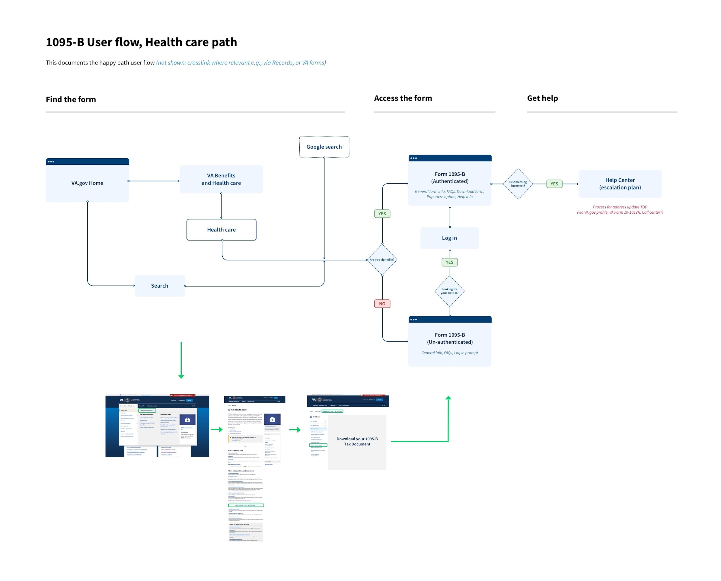
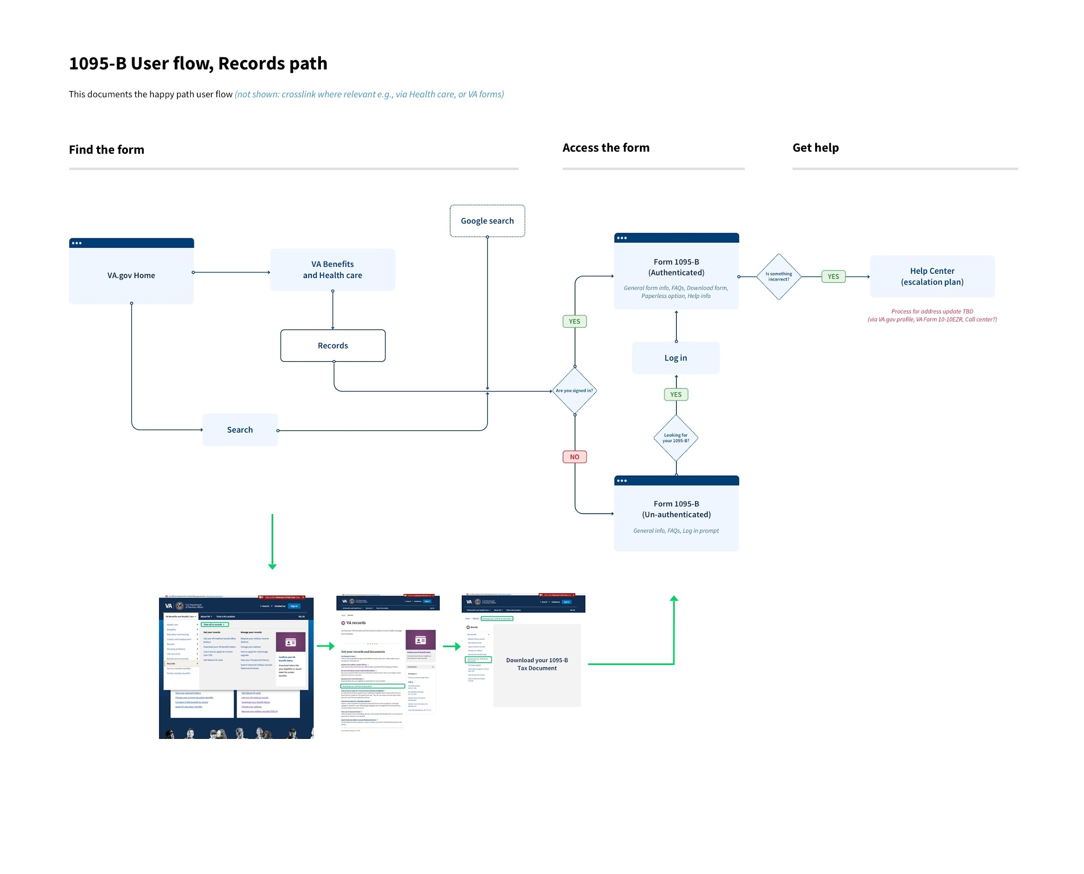
2
DESIGN
With our product vision in mind, we created the flow of how a Veteran would find the form
User Story: Draft the user flow and decision paths of how a Veteran would access the form
02-08 Sprint 1 Demo
‹#›
User Flow (Health Care Path) Link, User Flow (Records Path) Link

Slide 15
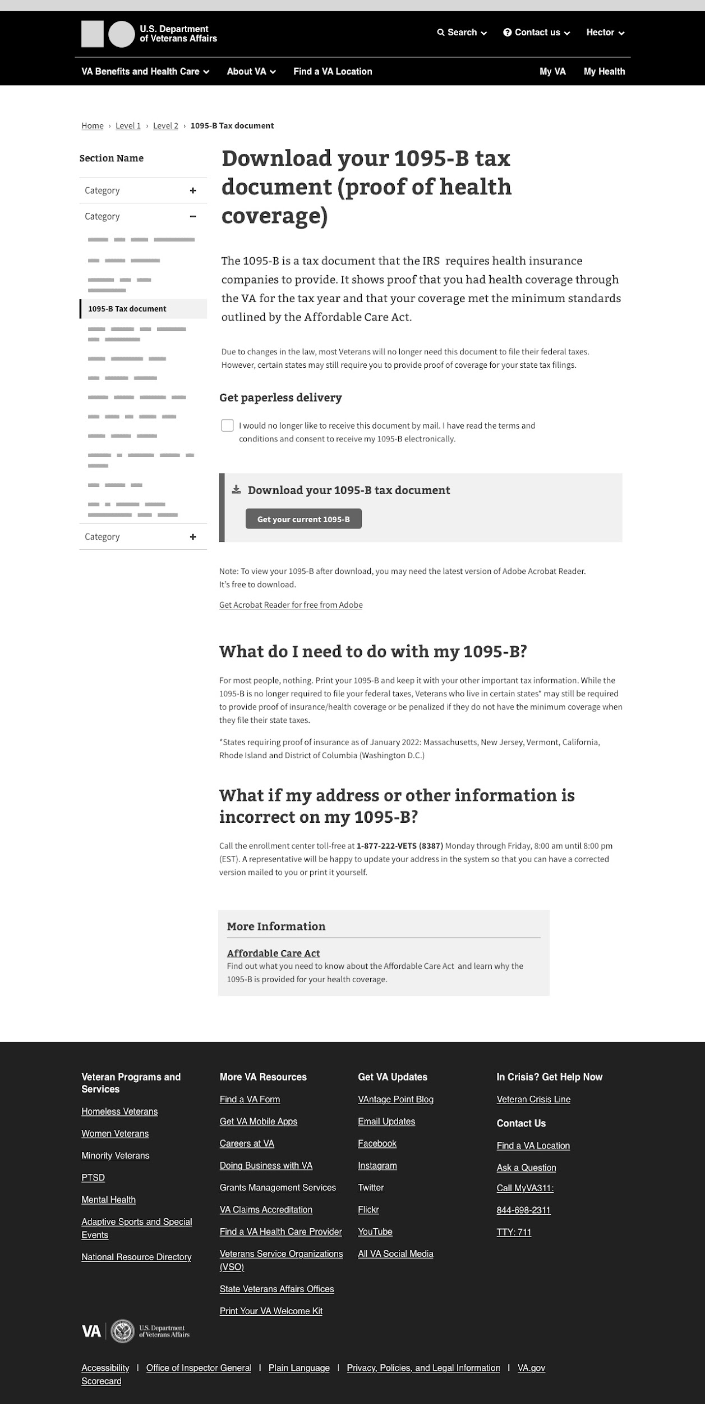
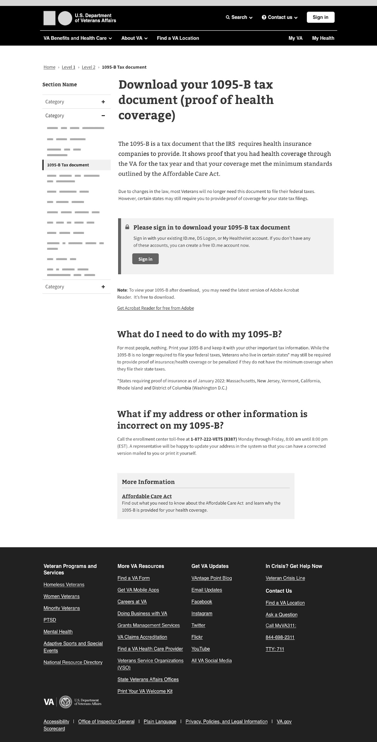
2
DESIGN
We focused on the landing page and created our first draft of what the experience would look like
User Story: Illustrate key moments in the Veteran’s happy path for future state to access and download the form
02-08 Sprint 1 Demo
Wireframes Link
‹#›

Slide 16
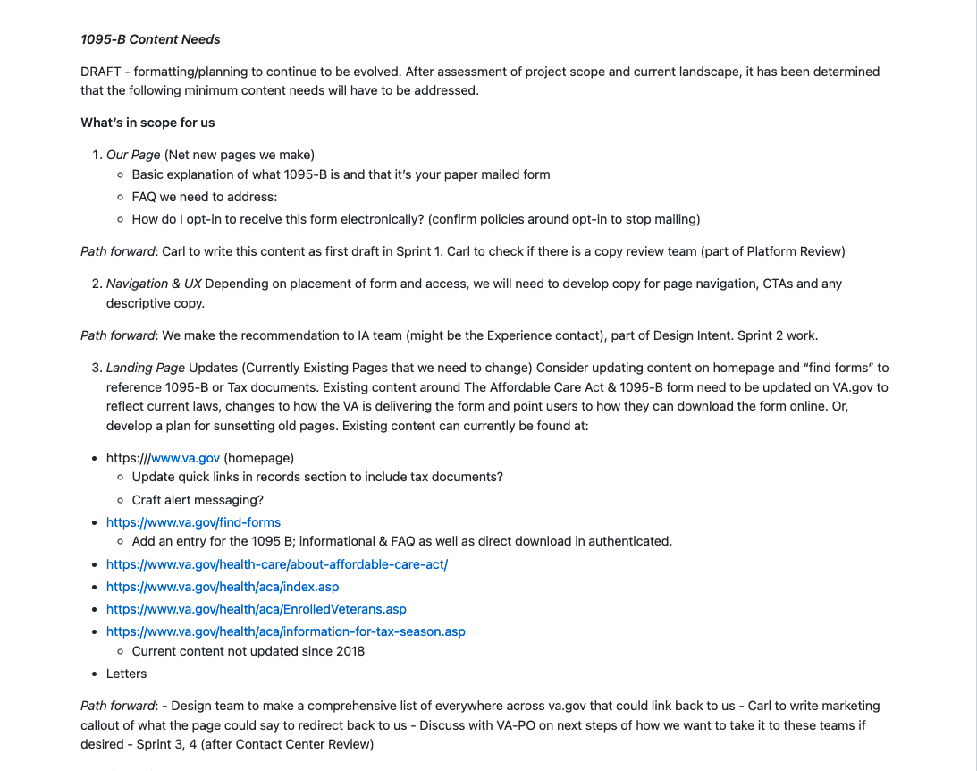
2
DESIGN
We identified what other content we need to create beyond our landing page
User Story: Write content for 1095-B pages
Other areas that will need to be re-directed to our 1095-B page:
Find forms
ACA
1095-B cover letter*
Notifications (TBD)
FAQs
*This may need to be further updated based on MVP functionality and developments in paperless opt-out process.
02-08 Sprint 1 Demo
‹#›
Content Needs Document, Content in wireframes

Slide 17
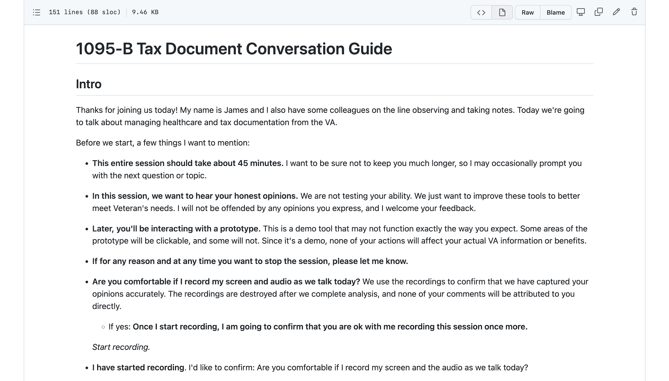
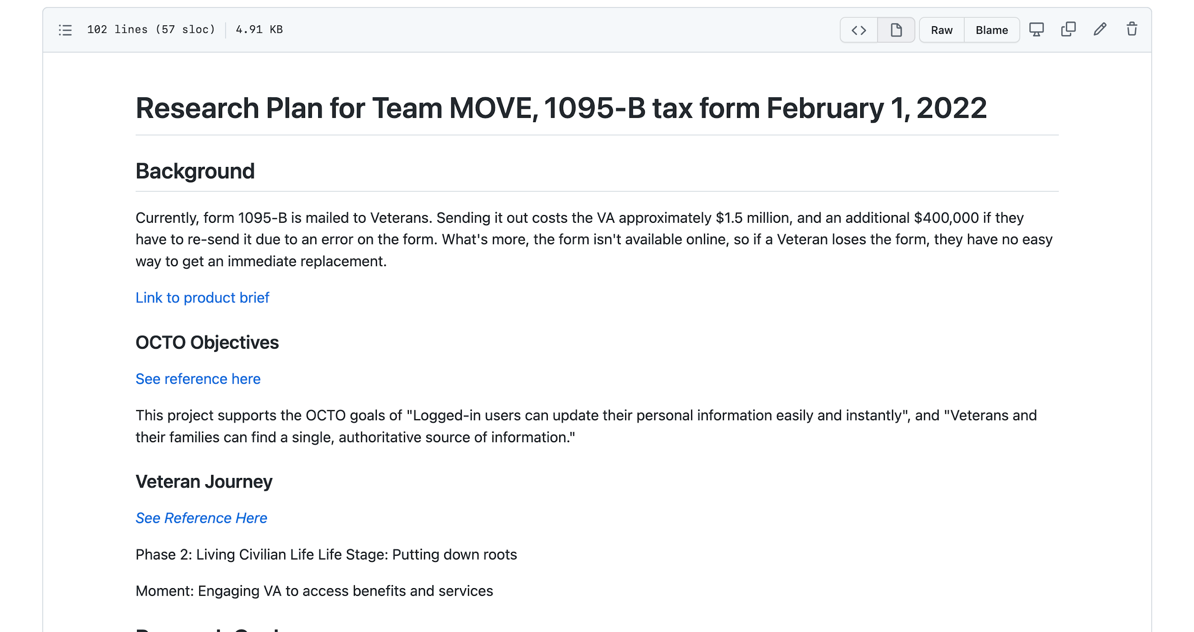
2
DESIGN
To validate what we are building, we prepared to begin user testing in the next sprint
User Story: Prepare for user research by creating the documentation needed to conduct research
Research goals
Better understand how Veterans might find, use, and edit a digital copy of the 1095-B form
Discover needs, pain points and preferences for physical or digital delivery of the form
Test usability of proposed solution
Format
Interview followed by a moderated usability testing session with a clickable prototype
Participants
6-8 Participants who currently utilize VA healthcare as their primary insurance and 2 - 4 Participants who use primarily access healthcare outside the VA system
Secondary criteria: Mix of users who file their taxes themselves (manually or software such as turbo tax), and those who use the services of a tax preparer or accountant
Scheduled for Friday Feb 11 – Wed Feb 16
02-08 Sprint 1 Demo
‹#›
Research plan, Conversation guide

Slide 18
3
TECH
After data discovery and exploring multiple options of how to build the form, we landed on one path forward
User Story: Conduct data discovery to understand where the data sits and what systems house the data we need
OPTIONS INVESTIGATED | OUTCOME OF DISCOVERY | Next Step
Option 1: Live API | While there is a live API that would fetch data from the Enrollment System, we need the data from a specific point in time (when it is sent to the print vendor) and if we were to use the live API there would be a discrepancy between the paper form and the digital form. | N/A – Not a viable option
Option 2A: Batch Data Export to DB | A batch job runs within the Enrollment System to put the needed enrollment data into a flat file (text delimited) in AWS S3, then a script inserts that data into a database table (i.e. AWS Aurora PGSQL). The VETS-API controller required can be built on a standard ‘CRUD’ model/controller in Rails. | Figure out how to set up S3 bucket and Aurora database, begin working on PDF generation
Option 2B: Batch Data Export to Flat File | We know that every time a Veteran calls to update their information, a new flat file would be sent via the batch script. As a result, we would have to merge the new flat file with the existing flat file, which creates enough added complexity that Option 2B becomes inferior to Option 2A. | N/A – Not a viable option
Option 3: Manual Export to S3 | Since there are already batch scripts to export to S3, manual export doesn't make sense. Additionally, we would not have a VA resource/individual to do the manual export. | N/A – Not a viable option
Option 4: Take PDFs directly from enrollment system | PDFs come back from the print vendor, making this a potentially viable path. However, the storage of so many PDFs would be too high. This could be a backup option. Delay of 10 days would be a potential issue, as data is less fresh. | If there is a serious roadblock with Option 2A we will revisit this option
02-08 Sprint 1 Demo
‹#›
Enrollment System Integration Options Link

Slide 19
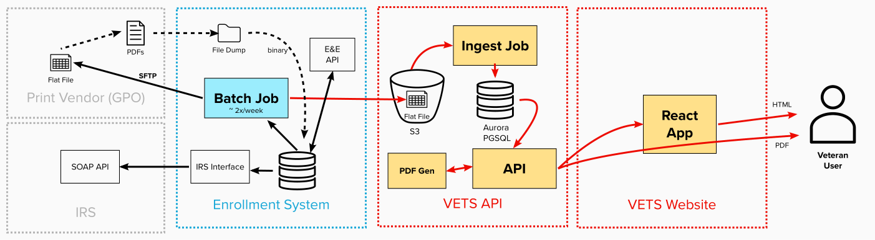
Systems outside of the VA
3
TECH
Existing enrollment system process
New components to be created by 1095-B team under existing systems
To help understand how our recommended option would work, we mapped out the data flow
User Story: Map out how the data flows through the systems in current state and how we would pull it in future state
Add footnote that batch job is 2x a week from Josh
Option 2A: Batch Data Export to DB
Batch job pulling data from enrollment system runs twice a week (from tech discovery with Josh)
02-08 Sprint 1 Demo
‹#›
Architecture Plan Document Link

Slide 20
Sprint 1 Deliverables
EPIC | STORY | ESTIMATE | ASSIGNED TO | OUTPUT | REVIEWED WITH VA-PO | SPRINT TEAM GOAL COMPLETED?
Product | #35968 Conduct product discovery through stakeholder interviews to pull insights | 5 | Carl | Stakeholder Interview Notes | N/A*
Product | #35970 Draft product outline | 3 | Jordan | Product Outline | 1/27/2022
Product | #35971 Draft prioritized backlog for MVP and post-MVP enhancements | 8 | Ashley | Zenhub Backlog Story map | 2/3/2022
Design | #36039 Draft the user flow and decision paths of how a Veteran would access the form | 5 | Grace | User flow (Health Care Path) User Flow (Records Path) User Flow Initial Draft & Comparative Research (Design Review deck) Updated User Flows & Paths (Design Review deck) | 2/1/2022, 2/4/2022
Design | #35969 Illustrate key moments in the Veteran happy path for future state | 8 | Jesse, Kit | Wireframes Concept Sketches (Design Review deck) Medium Fidelity Wires (Design Review deck) | 2/1/2022, 2/4/2022
Design | #36164 Write content for 1095-B pages | 8 | Carl | Content Needs document Content in wireframes Note: Added on 2/1; pulled up from Sprint 2 given additional design team capacity | 2/4/2022
Design | #35967 Prepare for user research by creating the documentation needed to conduct research | 13 | James | Research plan Conversation guide | 2/1/2022
Tech | #35965 Conduct data discovery to understand where the data sits and what systems house the data we need | 8 | Nadya | Enrollment System Integration Options 10-10EZ Research VA PDF_Fill Research | 1/31/2022
Tech | #35966 Map out how the data flows through the systems in current state and how we would pull it in future state | 8 | Jared, Nadya | Architecture Plan Document Architecture Diagram Mural | 2/7/2022
02-08 Sprint 1 Demo
‹#›
*VA-PO attended all stakeholder sessions alongside team so post-meeting debrief not needed Note: Not an exhaustive list of all stories completed in this sprint; does not include stories such as Platform Orientation, Offboarding, collaboration cycle meetings, etc.

Slide 21
SPRINT 1 DEMO
Preview of Sprint 2
02-08 Sprint 1 Demo
‹#›

Slide 22
Sprint 2 will run February 9th to the 23rd
Owned by design team
Owned by product/ engineering team
Release
Sprint 0
Sprint 1
Sprint 2
Sprint 3
Sprint 4
Sprint 5
Week 1: 01/20 – 01/26
Week 2: 01/26–02/02
Week 3: 02/02 – 02/09
Week 4: 02/09 – 02/16
Week 5: 02/16 – 02/23
Week 6: 02/23 – 03/02
Week 7: 03/02- 03/09
Week 8: 03/09 – 03/16
Week 9: 03/16 – 03/23
Week 10: 03/23 – 03/30
Product & Delivery
Build backlog
Create Change Management or Communications Plan
Handover plan implementation; prepare for launch
PIV Onboarding
Prioritized backlog
Product Launch Collaboration Cycle (as needed)
Immersion & onboarding
User Experience & Design
Immersion & onboarding
Testing prep
Testing prep & recruiting
Create post-MVP design refinements
Voice of Veteran
Voice of Veteran
PIV Onboarding
Wireframes & Design
Design iterations
Design iterations
Design QA
User flows
Engineering & Development
Create tech discovery plan
Data discovery
POC for data flow
Test & Refine
Immersion & onboarding
Define data flows - Systems mapping
Build solution (form UI, data connections, storage, etc.)
UAT
Collaboration Cycle
Kickoff
Analytics Review
Research Plan Review
Design Intent
Research Plan Review #2 (wireframes)
Midpoint Review
Contact Center Review
Privacy & Security review
Staging Review
MVP Launch
02-08 Sprint 1 Demo
*Does not show Validate phase meetings in Collaboration Cycle, such as Full Accessibility Audit and Post-Launch Check In
‹#›

Slide 23
Sprint 2 will focus on user testing and kicking off the build phase of our product*
User Story
1
PRODUCT
Create sprint by sprint product roadmap for 1095-B
Identify rollout plan needs
Document proposed process for how opt-in would work
2
DESIGN
Conduct UX testing and synthesize
Update designs to high-fidelity
Iterate designs based on Collaboration Cycle feedback
Iterate designs based on VA-PO feedback
Update research plan for second round of usability testing
Update conversation guide for second round of usability testing
3
TECH
Understand how to provision S3 bucket and database
Align with Technical POCs on approach and handoffs
Start POC (Proof of Concept) of generating a PDF using sample data
 | Next Sprint Demo: Tuesday, February 22nd
02-08 Sprint 1 Demo
‹#›
*Sprint 2 goals and stories are subject to change; stories to be finalized in Sprint 2 Planning based on demo feedback and team capacity

Slide 24
SPRINT 1 DEMO
Appendix
02-08 Sprint 1 Demo
‹#›

Slide 25
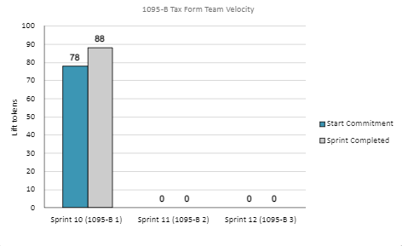
1095-B Sprint Team Velocity
Velocity Details
Velocity estimated in story points, using Fibonacci
All 78 story points committed at beginning of the sprint completed and team exceeded commitment in this sprint
Total completed for the sprint: 88 story points
Sprint 1 deliverables accounted for 66 points
20 points were for platform orientation for new team members
2 points were for offboarding members who left the team in this sprint
Added 10 points after sprint start as:
8 points were for a story pulled up from Sprint 2 since team had capacity to take on more work
2 new points were for additional new work that came up to offboard team members leaving the team this sprint
Velocity in Sprint 1 accounted for 10 team members
02-08 Sprint 1 Demo
‹#›

Slide 26

Project Risks and Mitigation Strategies
Serious risk
Some risks / delays
Everything is good
Submitted as part of the Monthly Report on February 7th
Risk and Impact | Mitigation Strategy | Date |  | Status | Notes
 |  | Entered | Closed
Laying a foundation of trust between MyHealtheVet and VA.gov teams. | Respect the collaboration gains and create meaningful moments to engage as a team. | 10/7/21 | 1/11/22 |  | Product turned over to VA
Operating in an environment with multiple stakeholders and many layers of support. | Create and maintain dynamic stakeholder matrix and RACI. | 10/7/21 | 1/11/22 |  | Product turned over to VA
Ramping the team after Kickoff may impact team norming. | Be super engaged and proactive with Champion at SteerCo meetings. | 10/7/21 | 12/5/21 |  | Team capacity for current work achieved
Confusing Veterans regarding MyHealtheVet functionality while consolidating appointment functions. | Stay in front of VSOs and TAP sources to impact habit patterns and collect secondary feedback. | 10/7/21 | 1/11/22 |  | Product turned over to VA
Reconciling the two different Terms of Service (ToS) across My HealtheVet and VA.gov. | Work to consolidate ToS early to prevent Health Apartment from being blocked. | 10/7/21 | 1/11/22 |  | Product turned over to VA
Operating in an environment with multiple stakeholders with many layers of influence and integration can lead to misaligned goals and competing priorities. | Develop a deliberate and persistent omnichannel approach to stakeholder engagement. Improved understanding with stakeholder session with Lauren on 9/20. | 10/7/21 | 12/5/21 |  | Stakeholder engagement facilitated through collaborations cycle initiation
Onboarding the landing team, building in governance, recruiting and staffing open roles, and building the backlog and roadmap could lead to misaligned expectations across work streams. Misaligned expectations on deliverables. | Communicate frequently and transparently. Align on the definition of done. | 10/7/21 | 1/11/22 |  | Product turned over to VA
There are a lot of unknowns around the technical aspect of the POC. Technical roadblocks could cause delays later in the program. | Build in time for technical discovery and research to identify the technical dependencies and highlight gaps that need to be addressed. | 10/7/21 | 1/11/22 |  | Product turned over to VA
Potential for government shutdown. Loss of access to VA team could lead to uncertainty on priorities, limited ability to remove blockers, and other delays. | Planned for work that could be done independently, but shutdown did not occur. | 9/30/21 11/3/21 | 1/11/22 |  | Product turned over to VA
02-08 Sprint 1 Demo
‹#›

Slide 27
Project Risks and Mitigation Strategies
Serious risk
Some risks / delays
Everything is good
Submitted as part of the Monthly Report on February 7th
Risk and Impact | Mitigation Strategy | Date |  | Status | Notes
 |  | Entered | Closed
Identify clear PIV process owner from VA Team. Dedicated Security Officer (Kemi) support ended mid Sept; dedicated Security Officer assistance not available to date. PIV forms loaded to VA Secure SharePoint site on 10/25. Four (4) people pending e-QIP initiation. Gap in process likely delay contract compliance and access to systems. | 11/1 MO Studio built an end-to-end PIV checklist based on other VA project work. Will request ad hoc support from Kemi to validate steps. Identify clear PIV process owner from VA Team. Dedicated Security Officer (Kemi) support ended mid Sept; dedicated Security Officer assistance not available to date. | 11/1/21 | 2/4/22 |  | 1/20/22 PIV responsibility turned over to MOVE team member with PIV access. 1/28/22 Training part I provided on VA security clearance and adjudication 2/4/22 Training part II for VA security and adjudication process
Recruiting, hiring, and onboarding candidates impacted not only by the tight labor market (i.e., "Great Resignation") but also the lack of clarity on Product Strategy and needed capabilities / skill sets on the team to deliver on expansive scope. Delivery teams pick up the workload as time to fill roles is extended. | Brought in external partner / Chief People Officer (Jen Tress) to redesign, deploy, and optimize recruiting, hiring and onboarding at MO. Piloting process in Lead Product Manager and optimizing with Design Lead, Tech Lead, Research Lead, etc. Creating cohorts of candidates and working them through a refreshed process through Feb and Mar 2022 to ideally hire and onboard in advance of Apr 1st. | 11/2/21 | Open |  | 5 individuals have been onboarded to the team as of 12/1.
02-08 Sprint 1 Demo
‹#›

Slide 28
Project Risks and Mitigation Strategies
Serious risk
Some risks / delays
Everything is good
Submitted as part of the Monthly Report on February 7th
Risk and Impact | Mitigation Strategy | Date |  | Status | Notes
 |  | Entered | Closed
Operating in an environment with multiple stakeholders and multiple layers of influence and integration can lead to misaligned goals and competing priorities. | Develop a deliberate and persistent omnichannel approach to stakeholder engagement. Improved understanding with stakeholder sessions with VA-PO. | 1/20/22 |  |  | Ongoing
There are a lot of unknowns around the technical aspect of product. Technical roadblocks could cause delays later in production. | Prioritized technical discovery and regular stakeholder engagement early in process to identify the technical dependencies and highlight gaps that need to be addressed. Proactively working with current CEDAR IDIQ / MOVE partners and exploring alternative paths to address any emerging capability gaps in expeditious manner. | 1/20/22
Potential for government shutdown. Loss of access to VA team could lead to uncertainty on priorities; limited ability to remove blockers, and other delays. | Plan for work that could be done independently to keep production moving forward. | 1/20/22 | `
IRS stakeholder is outside of VA ecosystem. Building without guidance or legal review regarding compliance with IRS regulation could result in sanctions or damage to reputation. | Conduct research on available information surrounding current IRS 1095-B tax form regulations. Seek legal review through VA resources. | 1/20/22
02-08 Sprint 1 Demo
‹#›

